Slide 1
Welcome to Advisory with Miss Chamoun and Mr. Weir!
To remember Miss C’s name: Chamoun rhymes with Timon (“Ta-mone”) from Timon and Pumba…Lion King…is that before your time?
My goal is to help you achieve yours. If we work together, we can achieve anything. I look forward to a GREAT year with you ☺!

Slide 2
Chamoun/Weir Schedule
8:25 AM Advisory/ REACH
Per. 1 Exploratory
Per. 2 Exploratory
Per. 3 Math/Sci or LA/SS
Per. 4 Math/Sci or LA/SS
Per. 5 Math/Sci or LA/SS

Slide 3
Chamoun/Weir Schedule
Per. 6 Lunch or Exploratory
Per. 7 Lunch or Exploratory
Per. 8 Math/Sci or LA/SS
Per. 9 Math/Sci or LA/SS
Per. 10 Math/Sci or LA/SS
Advisory

Slide 4
Chamoun/Weir PM Advisory Rotations
Monday: No PM Advisory
Tuesday: Silent reading day
Wednesday: Homefun time
Thursday: Recycling Day
Friday: Cleaning Day or Team Building Activity

Slide 5
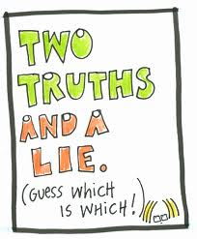
A little Sneak Peek about Miss Chamoun…
I really like Justin Bieber.
I’d love to own a farm and take care of pigs, horses, and cows.
I always knew I wanted to be a teacher growing up.

Slide 6
*I am OBSESSED with procedures! Procedures make the world go round and our classroom function as a safe and positive learning community ☺.
On that note, let’s learn the classroom procedures…

Slide 7
Classroom Procedures
Students will enter the classroom at 8:25AM.
Students will request permission from the teacher to leave the room at any time.
Students will be dismissed at the end of advisory by the teacher.
Students will raise their hand to speak.
Students will be silent when the lights are turned off, and will move to face the teacher.
Students will adhere to all school-handbook policies (i.e. cell phone, back packs, food, technology, etc.).

Slide 8
Job Chart for a Safe and Fun Learning Community ☺

Slide 9
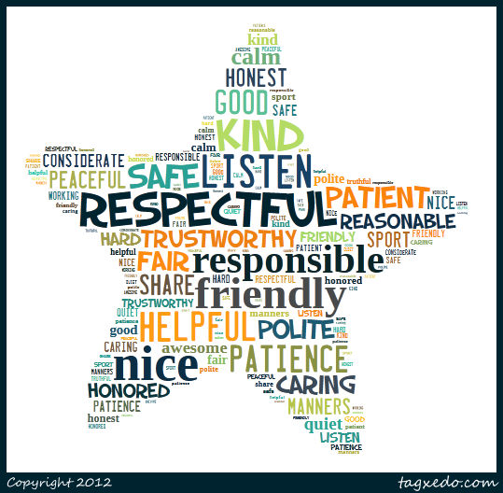
Classroom Expectations & Consequences
R-E-S-P-E-C-T
~Aretha Franklin

Slide 10
Consequences
First Time: Warning and private discussion with a teacher
Second Time: Private discussion with a teacher and signing an Accountability Sheet to go into your Portfolio
Third Time: Private discussion, signing another Accountability Sheet, student-led email or call home to parents during lunch or recess
Fourth Time: Same as the third offense, along with discussion with principal
Severe Disruptions: Student immediately sent to the office

Slide 11
Should I worry about the Accountability Sheets?
No!
Almost everybody will get one at one point. We’re human.
We only worry about them if they become a habit.

Slide 12
Rewards (The Good Stuff)
Praise (daily)
Star student award sticker (random)
Positive emails/letters home (random)
Student of the Month (monthly)
Various positive perks *i.e. no homefun pass, listening to iPod, etc. (throughout the year)
The joy of learning with Miss Chamoun and Mr. Weir ☺ (priceless reward every day)

Slide 13
A little Sneak Peek about Mr. Weir….
I am right-handed.
I am a White Sox fan.
I have played golf with Michael Jordan.

Slide 14
Helpful Information
Blog with daily activities and homework: www.MissChamoun.weebly.com
Email: daniellechamoun@winnetka36.org and jeffreyweir@winnetka36.org (This is the best way to reach me. **Disclaimer: I will NOT respond to emails after 7PM—sadly, I am often asleep by this time ☹).
Meeting Times:
Miss Chamoun→ Starting at 7AM until school begins, during lunch, and by appointment only after school.
Mr. Weir→ Starting at 7:45AM until school begins, during lunch, and by appointment only after school.

Slide 15
So will there be homefun?
Of course.
But…
It will likely only be a bit more than last year.
It will require you to be organized.
The assignment notebook is the key.
How much will there be?
No more than 1.5 hours any night, less most nights.
If it’s taking you longer, we need to find out why.

Slide 16
What does it mean to advocate?
Advocating is communicating with us about your needs (“sticking up for yourself”).
It may be the most important skill to work on this year (that and problem solving ☺).
We have over 40 kids and we can’t read your mind.
We really need to see you early
We have over 40 kids and we can’t read your mind
We really need to see you early if you…
We will never, ever be upset if you don’t understand something.

Slide 17
Random Stuff to Know…
We have no maid service at Skokie School.
KEEP HALL CLEAR OF STUFF AT ALL TIMES!!!!! THIS IS NOT FLEXIBLE, EVEN IF YOU ARE RUNNING LATE TO CLASS.
There are rules about where to be before 8:25.
Hats off unless outside
Cell phones kept off and in backpack
at all times during the school day.
Chairs stacked at the end of the day
(or you’ll do them all the next day!)

Slide 18
Snacks and Water
-You may bring a healthy snack for our morning break. (i.e. fruit or veggie)
(NO CHIPS, CRACKERS, SWEETS,
NO NUT PRODUCTS!)
-You may also bring a water bottle for use in the team classrooms. But please clean it out regularly.
-Birthday Snack: Store bought, nut-free, hassle-free packaged
-Make a mess? No treat the next day!

Slide 19
We are happy to have you on our team!
Questions? Comments? Concerns?
We are going to have a great year!

