Slide 1
Welcome to Miss Chamoun’s (Sha-mone ☺) 6th Grade English/Social Studies Class!
The Skokie School
2014-15

Slide 2
About Me
Park Ridge, IL
BA and MA from the University of Dayton
1 year in advertising
5th year teaching
College prep English, literature, gifted/talented small group
2nd year in the district
7-8th grade English at CW

Slide 3
English & Social Studies Curriculum
Writing
Literature
Independent Reading
Greek/Latin Roots and Affixes
Grammar
Ancient Civilzations

Slide 4
Integrated Approach
Beginnings
What does it mean to belong? How do challenges affect our sense of belonging?
Building Blocks of the Future
How does the past influence the future?
Legacy
How can we leave a positive legacy behind as global citizens?

Slide 5
Ancient Civilizations
Greece
Rome
Egypt
Middle Ages
Strategies to read non-fiction and informational text
Research strategies
Current events
Problem-solving skills
Model UN

Slide 6
Writing
Daily Responses to literature
Box Format
Inquiry based
Writers Workshop
Argument
Fiction
Informational
Grammar
Pronouns
Commas, dashes, parenthesis
Sentence structure/types
Rubric: Structure, development, language conventions
Writing Goals
Writing Portfolio

Slide 7
Literature
Book groups
Skilled or interest based
Theme based (essential questions)
Whole group text
Self-selected text and independent reading
Skills: Annotating, written responses, seminars

Slide 8
Independent Reading
Self-selected text
Minimum of one novel per month
Will not need to annotate
Create own IR questions
Work with Ms. Marut to create reading goals
Log reading and attainment of monthly goals

Slide 9
Vocabulary
Goal
Give students another tool to decode words
Research-based
High-frequency
Less is more
Depth not breadth
Survivor Vocab
1-2 Greek or Latin root/affix per week
Examples and context
“Vote off” 2-3/month
Last 25 will be assessed
Content-specific words (history)

Slide 10
Differentiated Instruction (DI)
Students come to the material from different levels and directions as a result from…
Different educational backgrounds
Different life experiences
Different areas of interest and readiness
Different natural areas of strengths and struggles
DI is based on interest and academic level
Levels assessed by preassessments and formative & summative assessments

Slide 11
Differentiated Instruction (DI)
What it looks likes in the classroom…
Flexible grouping/seating
Different homework assignments
Choice and autonomy
Small group vs. large group instruction
What is does NOT look like…
Students given “more” or “less” work or given “free time” based on their level
Permanent grouping
“Smart” students vs. “not smart” students
WHY differentiate?
Help each student achieve success based on his/her own level
Research-based by Carol Tomlinson

Slide 12
Oh Snap! Take a picture and save this…
Email*:daniellechamoun@winnetka36.org
Websites:
www.MissChamoun.weebly.com
*Unavailable during Class time, after 7PM, and weekends. Emergencies during the day, please call the office.

Slide 13
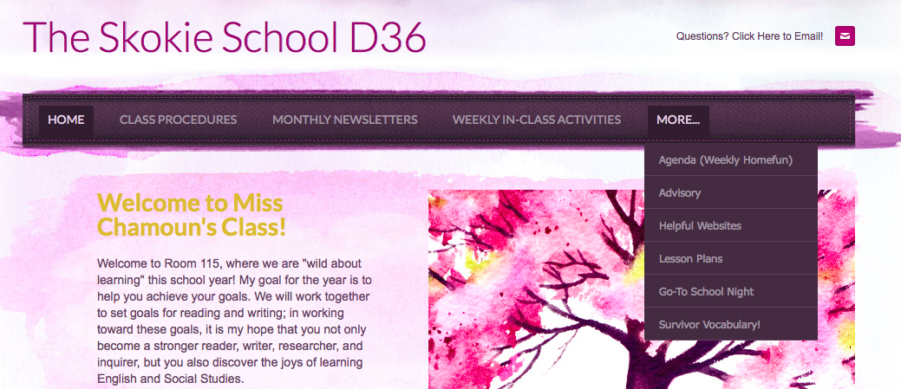
Helpful Links on Website
www.MissChamoun.weebly.com

