Slide 1
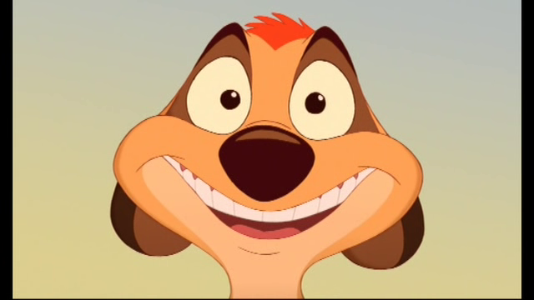
Welcome to Language Arts with Miss Chamoun!
To remember my name: Chamoun rhymes with Timon (“Ta-mone”) from Timon and Pumba…Lion King…is that before your time?
THEN START READING THE PAPER ON YOUR DESK!!!
My goal is to help you achieve yours. If we work together, we can achieve anything. I look forward to a GREAT year with you ☺!

Slide 2
*I am OBSESSED with procedures! Procedures make the world go round and our classroom function as a safe and positive learning community ☺.
On that note, let’s learn the classroom procedures…

Slide 3
Classroom Procedures
Students will view learning objectives and daily activities, and essential questions as well as perform the Bell Work immediately upon entering the classroom.
Students will write down their homework in their agenda/school planner the first day of the school week.
Students will request permission from the teacher to leave the room at any time.
Students will be dismissed at the end of class by the teacher.
Students will raise their hand to speak.
Students will look at the “What We Did” bulletin when returning from an absence to obtain work missed (also will be available on my blog).
Students will adhere to procedures set forth for (a) submitting late, missing, or absent work, (b) checking out books from the classroom library, (c) finding work without names on it, and (d) obtaining graded work.
Students will be silent when the lights are turned off, and will move to face the teacher.
Students will adhere to all school-handbook policies (i.e. cell phone, back packs, food, technology, etc.).

Slide 4
Classroom Materials *These should be with you EVERY DAY. Every. Day. I repeat: e-v-e-r-y-d-a-y.
Folder
Reading, Writing, and SS notebooks
Independent reading novel
Class/Book group novel (if applicable)
Writing utensil
Charged iPad
Homefun

Slide 5
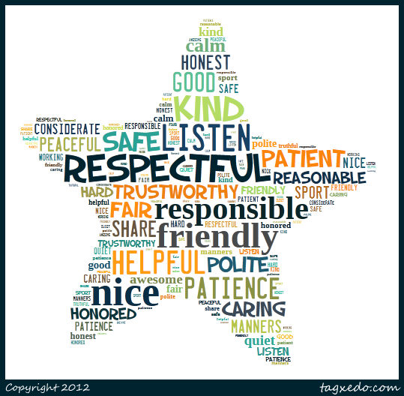
Classroom Expectations
R-E-S-P-E-C-T
~Aretha Franklin

Slide 6
Mission Statement
What is our classroom community goal for the year? What do you hope to accomplish individually and with your peers?

Slide 7
Consequences
First Time: Warning and private discussion with a teacher
Second Time: Private discussion with a teacher and signing an Accountability Sheet to go into your portfolio
Third Time: Private discussion, signing another Accountability Sheet, student-led email or call home to parents during lunch/recess
Fourth Time: Same as the third offense, along with discussion with principal
Severe Disruptions: Student immediately sent to the office

Slide 8
Rewards (The Good Stuff)
Praise (daily)
Star student award sticker (random)
Positive emails/letters home (random)
Student of the Month (monthly)
Various positive perks *i.e. no homefun pass, listening to iPod, etc. (throughout the year)
The joy of learning with Miss Chamoun ☺ (priceless reward every day)

Slide 9
Late Work and Extra Credit
*Homefun is expected to be submitted at the beginning of the class period; if not, students will adhere to the consequences described above and the following deductions will be applied to the homefun:
Assignments: 10% off the total earned/ Accountability Sheet Reflection
Extra Credit: Whole class extra credit for keeping a clean and safe learning community (to be discussed)
**If for some reason, you know that you will be late on an assignment (vacation, illness, etc.), please let a teacher know {if you can} 24 hours in advance, and no penalty will be applied.

Slide 10
Helpful Information
Blog with daily activities and homework: www.MissChamoun.weebly.com
Email: daniellechamoun@winnetka36.org (This is the best way to reach me. **Disclaimer: I will NOT respond to emails after 7PM—sadly, I am often asleep by this time ☹. If you email me before then, please check your email before you turn in for the night, as you will receive a response before 7PM).
Meeting Times:
Miss Chamoun→ Starting at 7AM until school begins, during lunch, and by appointment only after school.

Slide 11
And now time for some tough love….

Slide 12
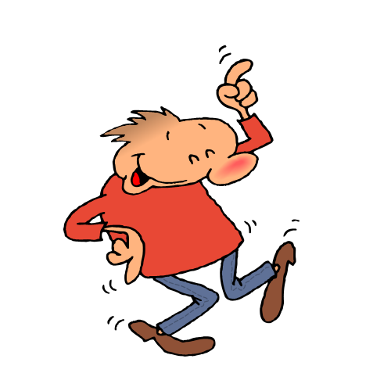
Now it’s time to boogey and move…
Please move to where you should look for the…
Essential Question
Daily Learning Target
Daily Activity
Bell Work
Exit Slip

Slide 13
Now it’s time to boogey and move…
Please move to where you should look for the…
Weekly agenda of HomeFun

Slide 14
Now it’s time to boogey and move…
Please move to where you should look for the…
Student Portfolio
Accountability Sheet

Slide 15
Now it’s time to boogey and move…
Please move to where you should look for the…
“Reading Takes Us Around the World” bulletin

Slide 16
Now it’s time to boogey and move…
Please move to where you should look for the…
Missing, absent, and late work turn-in tray

Slide 17
Now it’s time to boogey and move…
Please move to where you should look for the…
Classroom Library
Classroom library check out

Slide 18
Now it’s time to boogey and move…
Please move to where you should look for the…
“What We Did” bulletin where you look for work you missed while you were absent

Slide 19
Still moving and grooving but instead, let’s play a game!…
Pass the ball to the person next to you.
Where ever your thumb lands, that is the question you need to answer.
Please say your name, read the question, and give your answer.

Slide 20
Exit Slip→ Group work *Please complete with your table members
What does respect mean in the classroom? List 3-5 bullet points.
Turn it in when you are finished and this is your exit slip (meaning you can leave)
If I turn off the lights, please remember it means to stop and listen.

Slide 21
PLEASE GO TO MY TEACHER WEBSITE ON YOUR IPAD AND READ THE HOME PAGE (ABOUT ME!)
WELCOME!! It’s good to see I didn’t scare you off yesterday and you’re back again today ☺.
PLEASE SIT IN THE SEATS YOU WERE ASSIGNED YESTERDAY AND COMPLETE THE BELL WORK!!!
The web address is in the syllabus I gave you yesterday!

Slide 22
6th Grade Welcome Letter
I’ve told you a lot about me. Now it’s your turn to tell me about YOU!
Please write a letter on the paper provided for you, addressed to me, Miss Chamoun, and answer the following questions:
How do you feel about reading?
How do you feel about writing?
How do you feel about Social Studies?
Your letter should contain evidence (aka examples) to support your answers.
Finished? Hold onto it; I will collect it at the end of class. Read or find a book in the classroom library.

Slide 23
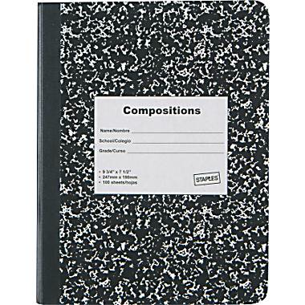
Dividing Your Reading Notebook
*Please use post-its to divide your notebook into the following 5 sections (I will show you some examples)
IR Goal
IR Log
IR writing
Vocabulary
Notes

Slide 24
Dividing Your Writing Notebook
*Please use post-its to divide your notebook into the following 3 sections (I will show you some examples)
Grammar
Brainstorm
Draft

Slide 25
Dividing Your Social Studies Notebook
*Please use post-its to divide your notebook into the following 10 sections (I will show you some examples)
Current Events
Belonging Notes
Belonging Vocabulary
Belonging Activities
Building Blocks Notes
Building Blocks Vocabulary
Building Blocks Activities
Legacy Notes
Legacy Vocabulary
Legacy Activities

Slide 26
Group work *Please complete with your table members
What are some good books you read over the summer OR last year?
Make a list IN YOUR NOTES SECTION of the Readers Notebook with your group to share with the class.

Slide 27
Independent Reading Log
Date | Book Title | Time or Pages

Slide 28
Independent Reading—What is it?
You will be expected to have an IR novel WITH you at all times.
First 15-20 minutes to read every day at the start of class.
You will be creating and answering questions about the books you read.
You will be creating IR goals and conferencing about these goals with me.
You will ALSO be expected to keep an IR log of the times you read and for how long.

Slide 29
Exit Slip
At the bottom/back side of your letter, please answer in 1 sentence each…
What do you expect from me as your teacher?
What is one fun fact about you?

