Slide 1
What does it mean to be beautiful in different countries? Source: Abc 7 chicago

Slide 2
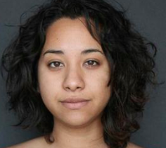
Natural…

Slide 3
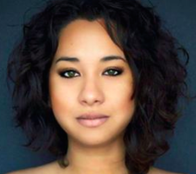
Macedonia

Slide 4
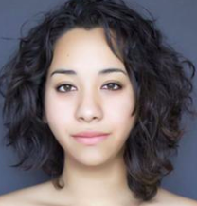
European union

Slide 5
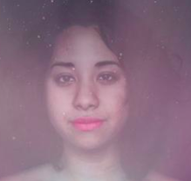
algeria

Slide 6
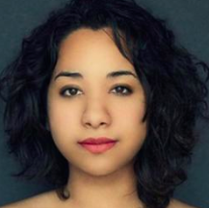
albania

Slide 7
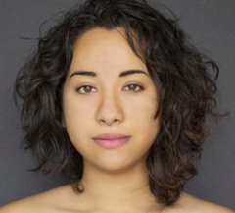
brazil

Slide 8
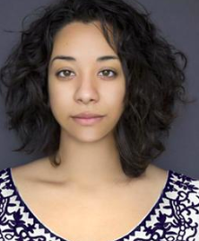
mexico

Slide 9
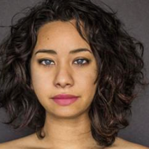
montenegro

Slide 10
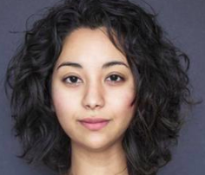
vietnam

Slide 11
netherlands

Slide 12
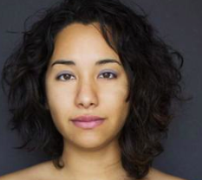
Israel

Slide 13
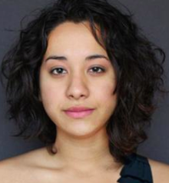
india

Slide 14
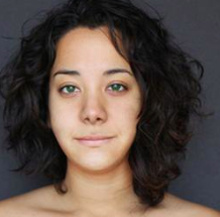
slovania

Slide 15
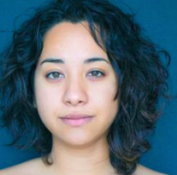
pakistan

Slide 16
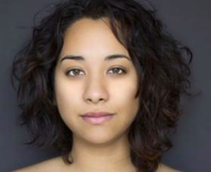
portugal

Slide 17
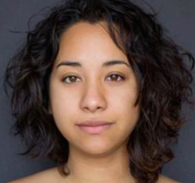
singapore

Slide 18
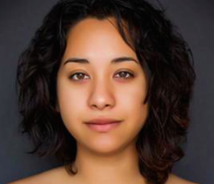
Sri lanka

Slide 19
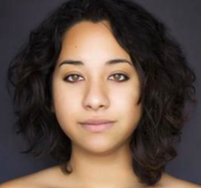
sweden

Slide 20
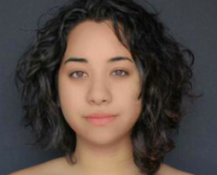
uk

Slide 21
usa

Slide 22
Seeing all the different pictures of beautiful, what does it mean to belong in different countries? Discuss with a partner first!

