Slide 1
Welcome to Miss Chamoun’s (Sha-mone ☺) Advisory!
The Skokie School
2014-15

Slide 2
Room Parent Sally Veenstra {Jack Veenstra’s mom}

Slide 3
About Me
Park Ridge, IL
BA and MA from the University of Dayton
1 year in advertising
5th year teaching
College prep English, literature, gifted/talented small group
2nd year in the district
7-8th grade English at CW

Slide 4
As the Advisor…
Primary Contact Person for Team: Absences, questions, relay messages to other teachers, concerns teachers may have…etc.
Provide a safe haven for students, as their home-away-from-home
Discuss themes that are relevant to their lives in order to develop the whole child: bullying, growing up, leadership and organization, community, service, self-advocacy, self-esteem, accountability etc.
School-wide theme: Choose Kindness

Slide 5
Advisory Goals…
Relationships: Student to teacher, student to self, and student to peer
Responsibility: Service, celebrations, classroom jobs and roles
Resilience: Provide support for successes and failures
Reflection: Discussion and written pieces

Slide 6
Advisory Activities…
Goal Setting (picture frames and conferences)
Field Trips
School and Winnetka/Chicago Community service
Team building activities

Slide 7
Snacks & Birthday Treats
Morning block snack
Healthy (fruit, veggies, etc.)
Small and packaged
Easy to clean up
Birthday Treats
Store bought with nutritional content
Nut-free
Packaged and easy to pass out (i.e. no sundae bar please!)
If it requires utensils, please bring them in!

Slide 8
Oh Snap! Take a picture and save this…
Email*:daniellechamoun@winnetka36.org
Websites:
www.MissChamoun.weebly.com
*Unavailable during Class time, after 7PM, and weekends. Emergencies during the day, please call the office.

Slide 9
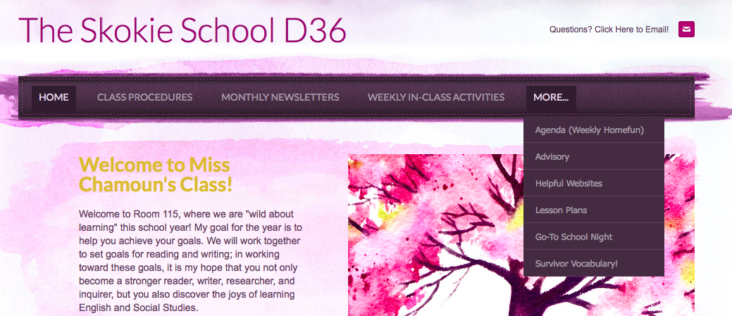
Helpful Links on Website
www.MissChamoun.weebly.com

Slide 10
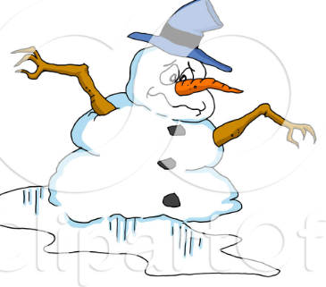
Parent Activity
Please take a moment to write a letter to your child…
What goals to you hope they accomplish? What do you like about their new room or classes? What are you most proud of?
These will be passed out to them during the dreary month of February!

Slide 11
And now a word from your children….

